Slide 1
Git-Version Control System

Slide 2
Agenda
Introduction to Devops
Introduction to Version Control System
Features and Architecture of GIT
Life Cycle of File in GIT
Git Installation On Windows
To Understand Working Directory, Staging Area and Local Repository
Git Commands With Example - init,status,add,commit,log and config

Slide 3
What is Devops?
Devops is not a new tool/Technology in the market.
It is a new culture or process to develop,release and maintain software products/projects/applications with high quality in very faster way.
We can achieve this in devops by using several automation tools.
For any software development,release and maintenance, there are two groups of engineers will work in the company.
1) Development Group2)Non-Development Group or Operations Group or Administrators Group.
Devops is combination of development and operations.
The main objective of devops is to implement collaboration between development and operations teams.

Slide 4
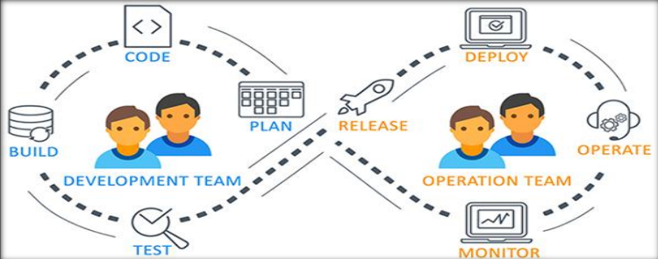
What is Devops?

Slide 5
Version Control System
A version control system, or VCS, tracks the history of changes as people and teams collaborate on projects together.
As developers make changes to the project, any earlier version of the project can be recovered at any time.
Developers can review project history to find out:
Which changes were made?
Who made the changes?
When were the changes made?
Why were changes needed?
VCSs give each contributor a unified and consistent view of a project, surfacing work that's already in progress.

Slide 6
The Basic Terminology of Version Control System
Working Directory: Where developers are required to create/modify files. Here version control is not applicable. Here we won't use the work like version-1, version2 etc
Repository: Where we have to store files and metadata. Here version control is applicable. Here we can talk about versions like version-1, version-2 etc
Commit: The process of sending files from working directory to the repository.
Checkout: The process of sending files from repository to working directory.

Slide 7
Benefits of Version Control System
1) We can maintain different versions and we can choose any version based on client requirement.
2) With every version/commit we can maintain metadata like commit message who did changes when he did the change what changes he did
3) Developers can share the code to the peer developers in very easy way.
4) Multiple developers can work in collaborative way
5) Parallel development.
6) We can provide access control like who can read code who can modify code

Slide 8
Types of Version Control Systems
1)Local Version Control
2) Centralized Version Control System /subVersion
3) De Centralized/Distributed Version Control System

Slide 9
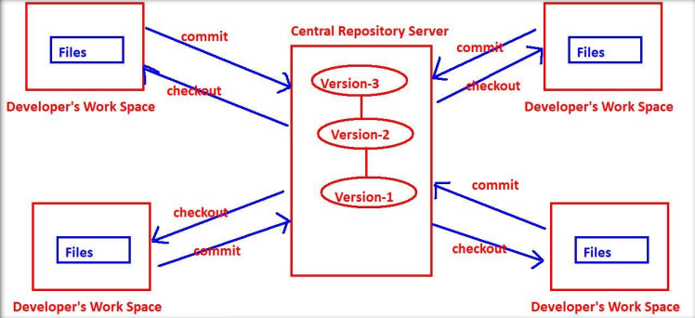
Centralized Version Control System

Slide 10
Problems with Centralized VCSs
Central Repository is the only place where everything is stored, which causes single point of failure.
If something goes wrong to the central repository then recovery is very difficult.
All commit and checkout operations should be performed by connecting to the central repository via network.
If network outage, then no version control to the developer.
All commit and checkout operations should be performed by connecting to the central repository via network and hence these operations will become slow, which causes performance issues.
Oranization of central repository is very complex if number of developers and files increases. etc

Slide 11
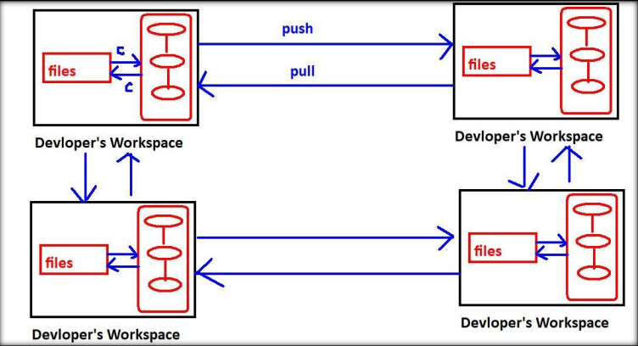
Distributed Version Control Systems
The name itself indicates the respository is distributed and every developers workspace contains a local copy of the repository.

Slide 12
Distributed Version Control Systems
1) The checkout and commit operations will be performed locally. Hence performance is more.
2) To perform checkout and commit operations network is not required. Hence if there is any network outage, still version control is applicable.
3) If something goes wrong to any repository there is a chance to recover. There is no question of single point of failure.
4) To perform push and pull operations network must be required, but these operations are not most common operations and we are performing very rarely.

Slide 13
Note
1) commit and checkout operations will be performed between workspace and repository.
work space – commit → Repository
Repository – checkout → workspace
2) push and pull operations will be performed between repositories.
one repository ---push →other repository
one repository ←pull----other repository

Slide 14
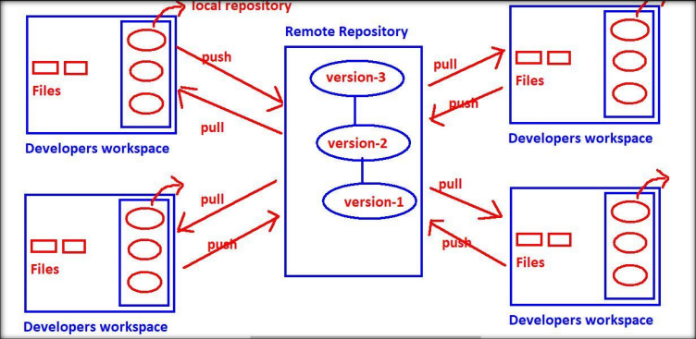
Distributed VCS with Remote Repository
Every developer has his own local copy of repository.
It is not centralized and it is distributed only.
commit and checkout operations won't be performed on remote repository and these will be performed on local repository only.
The main job of remote repository is just to share our work to peer developers.
High availability, Speed and there is no single point of failure are main reasons for popularity of this model.
Eg: Git, Mercurial, Fossi

Slide 15
What is Git?
Git is Distributed Version Control System Tool.
Git is not acronym and hence no expansion.
But most of the people abbreviated as "Global Information Tracker".
GIT is developed by Linus Torvalds(Finnish software engineer), who also developed Linux Kernel.
Most of the companies like Microsoft,Facebook,Yahoo, LinkedIn ,Intel using Git as Version Control System Tool.

Slide 16
Features of Git-Distributed
Git is developed based on Distributed Version Control System Architecture. Because of Distributed Architecture it has several advantages:
A) Every Developer has his own local repository. All the operations can be performed locally.Hence local repo and remote repo need not be connected always.
B) All operations will be performed locally, and hence peformance is high when compared with other VCSs. i.e it is very speed
C) Most of operations are local. Hence we can work offline most of the times.
D) There is no single point failure as Every Developer has his own local repository.
E) It enables parellel development & automatic-backups.

Slide 17
Features of Git-Staging area
It is also known as index area.
There is logical layer/virtual layer in git between working directory and local repository.
Working Directory → Staging Area → Local Repository We cannot commit the files of working directory directly.
First we have to add to the staging area and then we have to commit.
This staging area is helpful to double check/cross-check our changes before commit.
Git stores files in repository in some hash form, which saves space.
GIT will uses internally snapshot mechanism for this.
All these conversions and taking snapshots of our data will be happened in staging area before commit.

Slide 18
Features of Git-Branching and Merging
We can create and work on multiple branches simultaneously and all these are branches are isolated from each other.
It enables multiple work flows. We can merge multiple braches into a single brach.
We can commit branch wise also.
Moving files in GIT is very easy as GIT automatically tracks the moves.
Whereas in other VCS we need to create a new file & then delete the old one.
Freeware and Open Source
It provides support for multiple platforms.

Slide 19
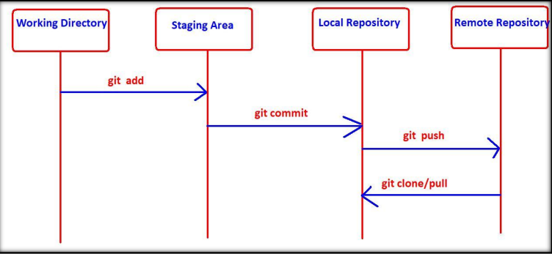
Git Architecture

Slide 20
Git Basic Commands
git add - To add files from working directory to staging area.
git commit - To commit changes from staging area to local repository.
git push - To move files from local repository to remote repository.
git clone - To create a new local repository from the remote repository.
git pull -To get updated files from remote repository to local repository.

Slide 21
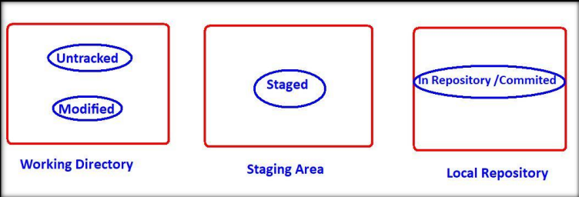
Life Cycle of File in GIT
1)Untracked: The files which are newly created in working directory and git does not aware of these files are said to be in untracked state.
2)Staged: The files which are added to staging area are said to be in staged state. These files are ready for commit.
3)In Repository/ Committed: Any file which is committed is said to be In Repository/Committed State.
4)Modified: Any file which is already tracked by git, but it is modified in working directory is said to be in Modified State.

Slide 22
Git init
Once we creates workspace, if we want version control, then we require a local repository.
To create that local repository we have to use git init command.
$ git init
Initialized empty Git repository in D:/gitprojects/project1/.git/
.git is an empty repository, which is hidden directory.

Slide 23
Git status
It shows the current status of all files in each area, like which files are untracked, which are modified, which are staged etc.
$ git status
On branch master
Changes not staged for commit

Slide 24
Git add
To add files from working directory to staging area for tracking/commiting purpose, we have to use git add command.
i) To add all files present in current working directory
git add .
ii) To add one or more specified files
git add a.txt
git add a.txt b.txt
iii) Even we can use pattern also
git add *.txt
git add *.java

Slide 25
Git commit
If we want to commit staged changes, then we have to use git commit command. git commit -m "commit message"
For every commit, a unique commit id will be generated.
It is of 40-length hexadecimal string.
$ echo -n "df4bb05e36e672698251e05e09d92ba45ea1fc47" | wc -c 40
The first 7 characters also unique, by using that also we can identify commit.
This unique id is considered as hash, which is generated based on content of files.
The advantages of this hash are
1) Data inside our local repository is more secure.
2) git requires less space to store contents of files.

Slide 26
Git log
It shows history of all commits.
It provides commit id, author name,maild , timestamp and commit message.
lenovo@DESKTOP-ECE8V3R MINGW64 /d/gitprojects/project1 (master)
$ git log commit 9a33a5b2e0d1c90eff544a3710b599be3c22665e
Author: Priyanka
Date: Thu May 14 22:16:59 2020 +0530
Added two files a.txt and b.txt
There are multiple options available with git log command.
git log --help

Slide 27
Git config
We can use this command to configure git like user name, mail id etc
git config --global user.email “piyu1818@gmail.com”
git config --global user.name “PriyankaN“
***Note: global means these configurations are applicable for all repositories created by git.
If we are not using global then it is applicable only for current repository.
$ git config --list →To list out all git configurations
$ git config user.name →To display user name
$ git config user.email →To display user email
We can change user name and mail id with the same commands

